Slide 1
UNIT-II GRAPHS
Prof. Arya C.S.

Slide 2
Covering the following topics
Graph terminology: vertex, edge, adjacent, incident, degree, cycle, path, connected component, spanning tree
Types of graphs: undirected, directed, weighted
Graph representations: adjacency matrix, array adjacency lists, linked adjacency lists
Graph search methods: breath-first, depth-first search
Algorithms:
  to find a path in a graph
  to find the connected components of an undirected graph
  to find a spanning tree of a connected undirected graph

Slide 3
Graphs
G = (V,E)
V is the vertex set.
Vertices are also called nodes and points.
E is the edge set.
Each edge connects two vertices.
Edges are also called arcs and lines.
Vertices i and j are adjacent vertices iff (i, j) is an edge in the graph
The edge (i, j) is incident on the vertices i and j

Slide 4
Graphs
Undirected edge has no orientation (no arrow head)
Directed edge has an orientation (has an arrow head)
Undirected graph – all edges are undirected
Directed graph – all edges are directed
u
v
u
v
undirected edge
directed edge

Slide 5
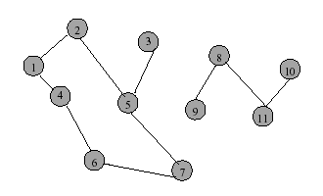
Undirected Graph

Slide 6
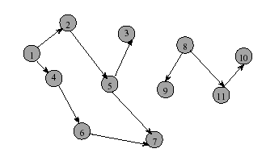
Directed Graph (Digraph)

Slide 7
Directed Graph
It is useful to have a slightly refined notion of adjacency and incidence
Directed edge (i, j) is incident to vertex j and incident from vertex i
Vertex i is adjacent to vertex j, and vertex j is adjacent from vertex i
In Figure 16.1, which graphs are undirected and which graphs are directed?

Slide 8
Applications – Communication Network
vertex = router
edge = communication link

Slide 9
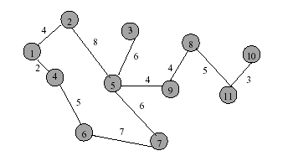
Applications - Driving Distance/Time Map
vertex = city
edge weight = driving distance/time

Slide 10
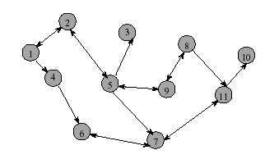
Applications - Street Map
Streets are one- or two-way.
A single directed edge denotes a one-way street
A two directed edge denotes a two-way street
Read Example 16.1 and see Figure 16.2

Slide 11
Path
A sequence of vertices P = i₁, i₂, …, i_{k} is an i₁ to i_{k} path in the graph G=(V, E) iff the edge (i_{j}, i_{j+1}) is in E for every j, 1≤ j < k
What are possible paths in Figure 16.2(b)?

Slide 12
Simple Path
A simple path is a path in which all vertices, except possibly in the first and last, are different
What are possible simple paths in Figure 16.2(b)?
Do Exercise 16.1 and explain why or why not

Slide 13
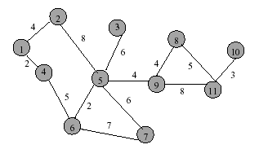
Length (Cost) of a Path
Each edge in a graph may have an associated length (or cost). The length of a path is the sum of the lengths of the edges on the path
What is the length of the path 5, 9, 11, 10?

Slide 14
Subgraph & Cycle
Let G = (V, E) be an undirected graph
A graph H is a subgraph of graph G iff its vertex and edge sets are subsets of those of G
A cycle is a simple path with the same start and end vertex
List all cycles of the graph of Figure 16.1(a)?
  1, 2, 3, 1
  1, 4, 3, 1
  1, 2, 3, 4, 1
Do Exercise 16.5

Slide 15
Spanning Tree
Let G = (V, E) be an undirected graph
A connected undirected graph that contains no cycles is a tree
A subgraph of G that contains all the vertices of G and is a tree is a spanning tree
A spanning tree has n vertices and n-1 edges
What are possible spanning trees in Figure 16.1(a)?
  ➔ See spanning trees of Figure 16.1(a) in Figure 16.3

Slide 16
Spanning Trees
What are the possible spanning trees for this tree?
What is the cost of each spanning tree?

Slide 17
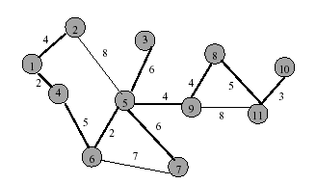
Minimum-Cost Spanning Tree (MCST)
The spanning tree that costs the least is called the minimum-cost spanning tree
See Figure 16.4
Which tree is the MCST of the example tree given in the previous page? What is its cost?

Slide 18
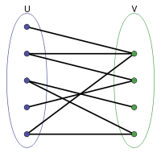
Bipartite Graph
A bipartite graph is a special graph where the set of vertices can be divided into two disjoint sets U and V such that no edge has both end-points in the same set.
A simple undirected graph G = (V, E) is called bipartite if there exists a partition of the vertex set V = V₁ U V₂ so that both V₁ and V₂ are independent sets.
Read Example 16.3 and see Figure 16.5
Do Exercise 16.7

Slide 19
Graph Properties

Slide 20
Number of Edges – Undirected Graph
Each edge is of the form (u,v), u != v.
The no. of possible pairs in an n vertex graph is n*(n-1)
Since edge (u,v) is the same as edge (v,u), the number of edges in an undirected graph is n*(n-1)/2
Thus, the number of edges in an undirected graph
is ≤ n*(n-1)/2

Slide 21
Number of Edges - Directed Graph
Each edge is of the form (u,v), u != v.
The no. of possible pairs in an n vertex graph is n*(n-1)
Since edge (u,v) is not the same as edge (v,u), the number of edges in a directed graph is n*(n-1)
Thus, the number of edges in a directed graph is ≤ n*(n-1)

Slide 22
Vertex Degree
The degree of vertex i is the no. of edges incident on vertex i.
e.g., degree(2) = 2, degree(5) = 3, degree(3) = 1

Slide 23
Sum of Vertex Degrees
Sum of degrees = 2e (where e is the number of edges)

Slide 24

In-Degree of a Vertex
In-degree of vertex i is the number of edges incident to i (i.e., the number of incoming edges).
e.g., indegree(2) = 1, indegree(8) = 0

Slide 25
Out-Degree of a Vertex
Out-degree of vertex i is the number of edges incident from i
(i.e., the number of outgoing edges).
e.g., outdegree(2) = 1, outdegree(8) = 2

Slide 26
Sum of In- and Out-Degrees
Each edge contributes
1 to the in-degree of some vertex and
1 to the out-degree of some other vertex.
Sum of in-degrees = sum of out-degrees = e,
where e is the number of edges in the digraph.

Slide 27
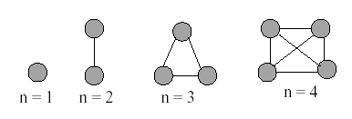
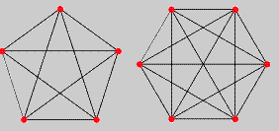
Complete Undirected Graphs
A complete undirected graph has n(n-1)/2 edges (i.e., all possible edges) and is denoted by K_{n}
What would a complete undirected graph look like when n=5? When n=6?

Slide 28
Complete Directed Graphs
A complete directed graph (also denoted by K_{n}) on n vertices contains exactly n(n-1) edges
See Figure 16.7 for complete digraphs for n = 1, 2, 3 and 4
What would a complete directed graph look like when n=5? When n=6?
Do Exercise 16.9

Slide 29
ADT graph
See ADT 16.1 for the abstract data type specification of a graph
See Program 16.1 for the abstract class definition of graph

Slide 30
Sample Graph Problems
Path Finding Problems
Connectedness Problems
Spanning Tree Problems

Slide 31
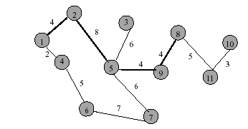
Path Finding
Path between 1 and 8
What is a possible path & its length?
A path is 1, 2, 5, 9, 8 and its length is 20.

Slide 32
Another Path Between 1 and 8
Path length is 28.
What is the path?

Slide 33
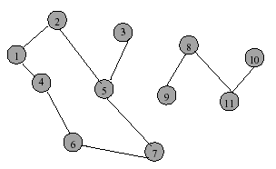
Example of No Path
No path between 2 and 9.

Slide 34
Connected Graph
Let G = (V, E) be an undirected graph
G is connected iff there is a path between every pair of vertices in G

Slide 35
Example of Not Connected

Slide 36
Example of Connected Graph

Slide 37
Connected Component
A connected component is a maximal subgraph that is connected.
A connected graph has exactly 1 component.

Slide 38
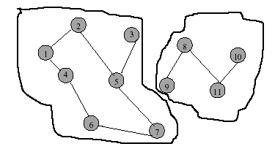
Connected Components

Slide 39
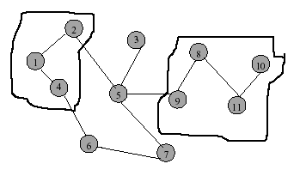
Not a Component

Slide 40
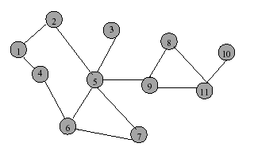
Communication Network
Each edge is a link that can be constructed
(i.e., a feasible link)

Slide 41
Communication Network Problems
Is the network connected?
  Can we communicate between every pair of cities?
Find the components.
Want to construct the smallest number of
feasible links so that resulting network is connected.

Slide 42
Cycles and Connectedness
Removal of an edge that is on a cycle does not
affect connectedness.
Which edges can be removed without affecting the connectedness?

Slide 43
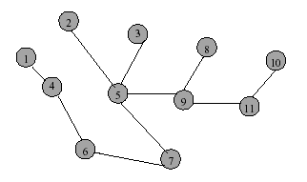
Cycles and Connectedness
Connected subgraph with all vertices and minimum number of edges has no cycles.

Slide 44
Representation of Unweighted Graphs
The most frequently used representations for unweighted graphs are
  Adjacency Matrix
  Linked adjacency lists
  Array adjacency lists

Slide 45
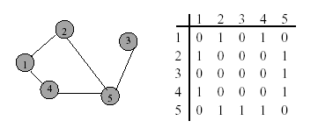
Adjacency Matrix
0/1 n x n matrix, where n = # of vertices
A(i, j) = 1 iff (i, j) is an edge.

Slide 46
Adjacency Matrix Properties
Diagonal entries are zero.
Adjacency matrix of an undirected graph is symmetric (A(i,j) = A(j,i) for all i and j).

Slide 47
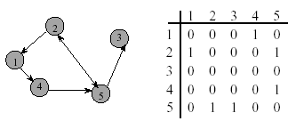
Adjacency Matrix for Digraph
Diagonal entries are zero.
Adjacency matrix of a digraph need not be symmetric.
See Figure 16.9 for more adjacency matrices

Slide 48
Adjacency Matrix Complexity
n² bytes of space is needed to represent adjacency matrix
For an undirected graph, we may store only lower or upper triangle (exclude diagonal): (n-1)n/2 bytes.
See Figure 16.10 for adjacency matrices of Figure 16.9 with diagonals eliminated
Requires O(n) time to find vertex degree and/or vertices adjacent to a given vertex.

Slide 49
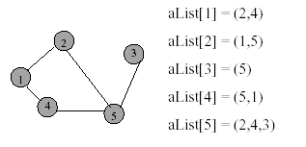
Adjacency Lists
Adjacency list for vertex i is a linear list of vertices adjacent from vertex i.
An array of n adjacency lists for each vertex of the graph.

Slide 50
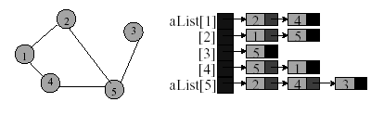
Linked Adjacency Lists
Each adjacency list is a chain.
Array length = n.
# of chain nodes = 2e (undirected graph)
# of chain nodes = e (digraph)
See Figure 16.11 for more linked adjacency lists

Slide 51
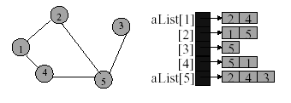
Array Adjacency Lists
Each adjacency list is an array list.
Array length = n.
# of chain nodes = 2e (undirected graph)
# of chain nodes = e (digraph)
See Figure 16.12 for more array adjacency lists

Slide 52
Representation of Weighted Graphs
Weighted graphs are represented with simple extensions of those used for unweighted graphs
The cost-adjacency-matrix representation uses a matrix C just like the adjacency-matrix representation does
Cost-adjacency matrix: C(i, j) = cost of edge (i, j)
Adjacency lists: each list element is a pair
(adjacent vertex, edge weight)
See Figure 16.13 for cost-adjacency matrices
See Figure 16.14 for linked adjacency lists for weighted graph

Slide 53
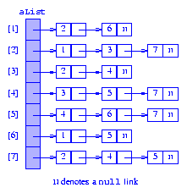
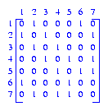
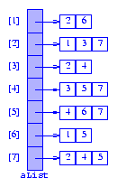
Exercise 16.17 – for the digraph Figure 16.2(b)
(a) adjacency matrix
(b) Linked adjacency list
(c) Array adjacency list

Slide 54
READING
READ Sections 16.1 - 16.7

